Slide 1
INTERNSHIP PROGRAMME (MSTY)
TRAINING PROGRESS MONITORING
Prepared By : ALVIN ANAK SAMAIL

Slide 2
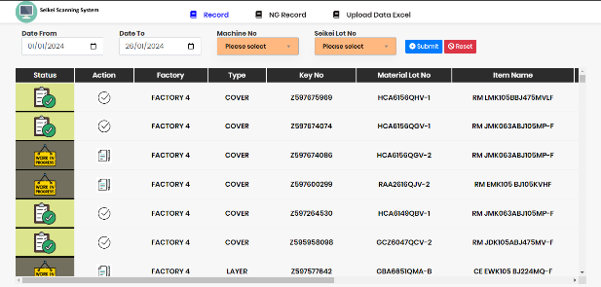
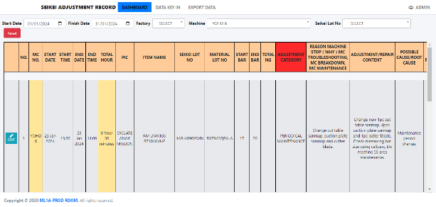
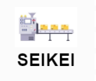
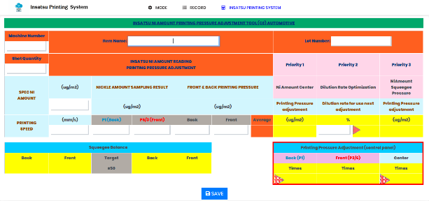

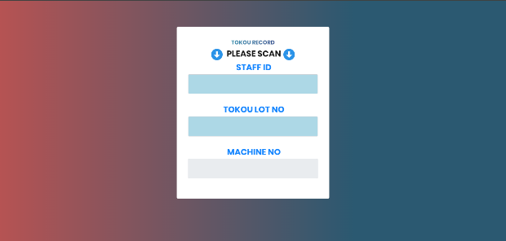


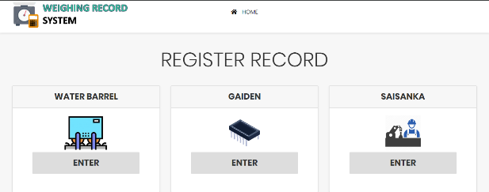

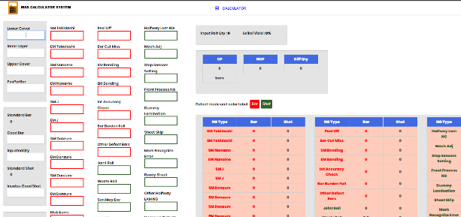

Internship Training Project
Seikei Scanning System
Insatsu Printing System
Weighing Record System
MSS Calculator System
Seikei Adjustment Record System
Haigou Tokou Scanning System

Slide 3
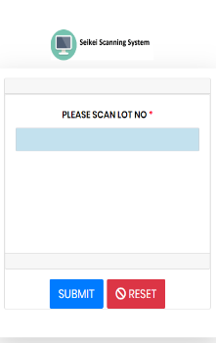
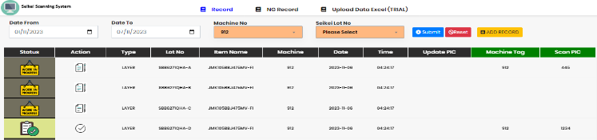
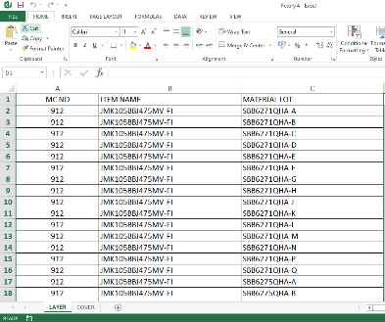
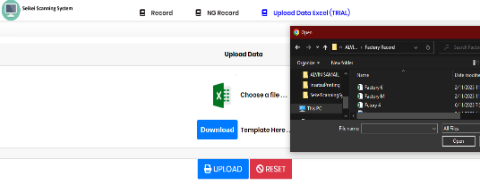
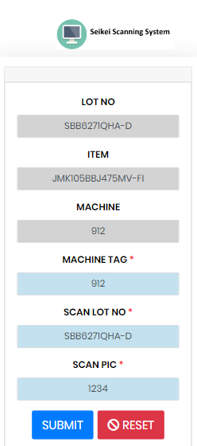



Seikei Scanning System
Design the UI data viewer :
Data insertion into table :
Data record for machine process :
List of Data Record
Tablet Scanner
Read
Create
List of Data Record
Web System Data Converter
Excel Data Fomat
Create
Read
Update
Start
Machine Process
Tablet Scanner
Data Viewer & Scanner
Data Evaluation

Slide 4
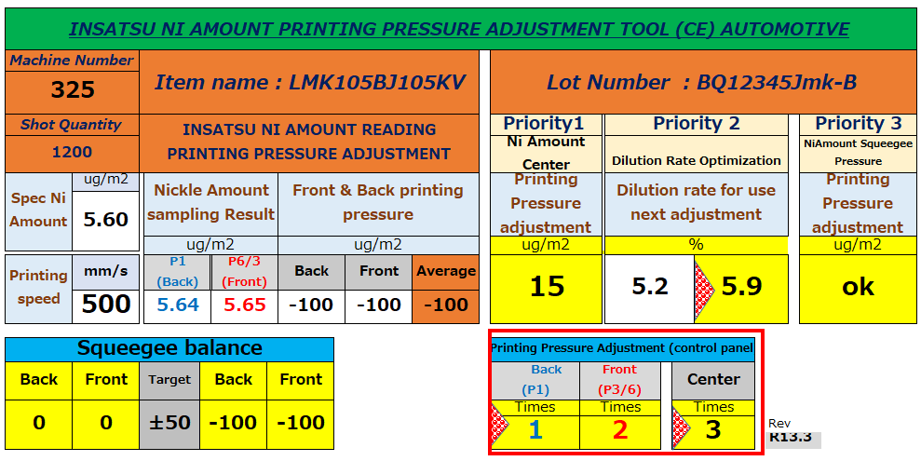
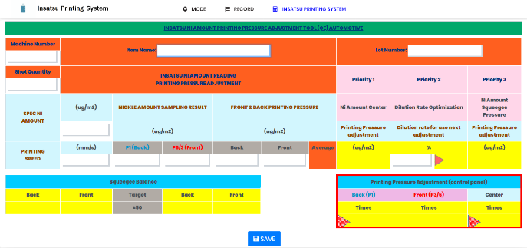


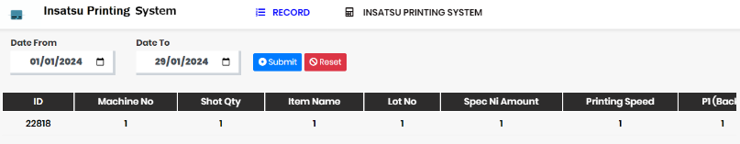
Insatsu Printing System
Sketch and Develop the UI :
Develop the calculation function for the web system :
Storing the calculation data inside the database :
Create
Excel System UI
Web System UI
Computer
Create
Update
Calculator
Web Calculation System
Create
List of Data Calculation Record
Web Calculation System

Slide 5
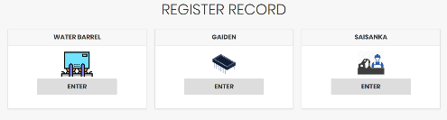
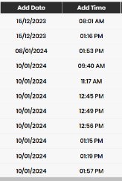


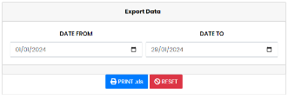

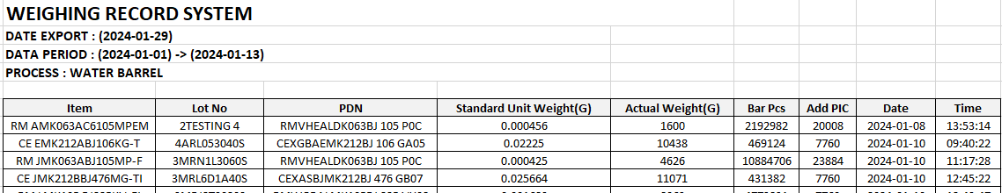
Weighing Record System
Standardize the UI of the system :
Adding new data record view :
Data record in web system conversion into excel :
Main Menu
Create
Data Record
Read
Create
MS Excel
Excel Data Format Record
Data Filter Record

Slide 6
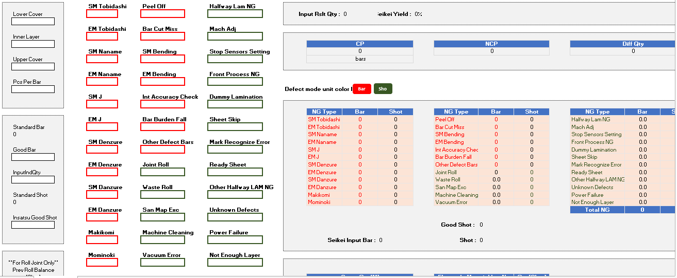
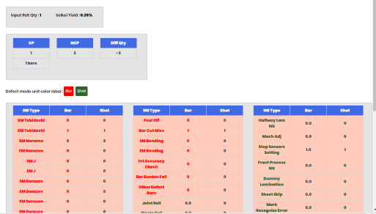
MSS Calculator System
Sketch and develop the UI :
Develop the calculation function for the web :
Create
Excel System UI
Web System UI
Create
Update
Computer
Calculator
Web Calculation System

Slide 7
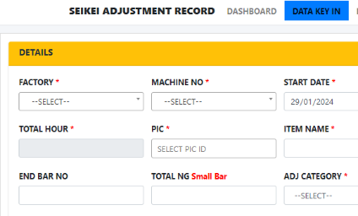
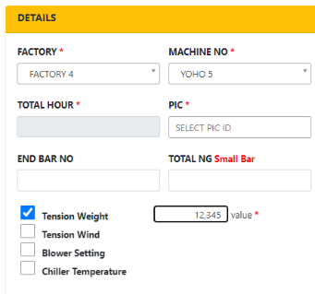
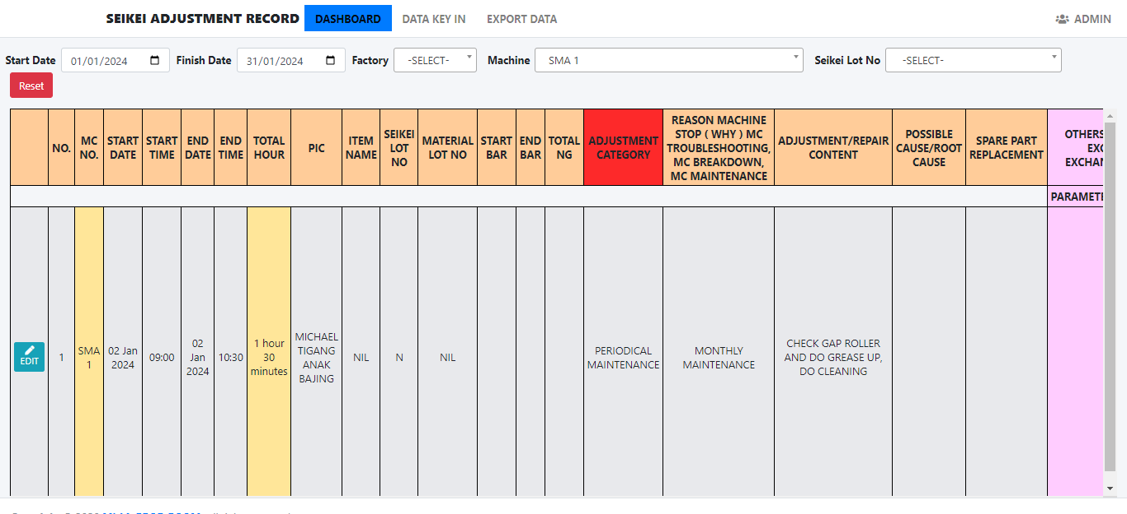
Seikei Adjustment Record System
Create the data insertion for new machine :
Update the filter for the new machine :
Create
Options
Data Entry
Data Record Filter
Read
Data Filtered List

Slide 8
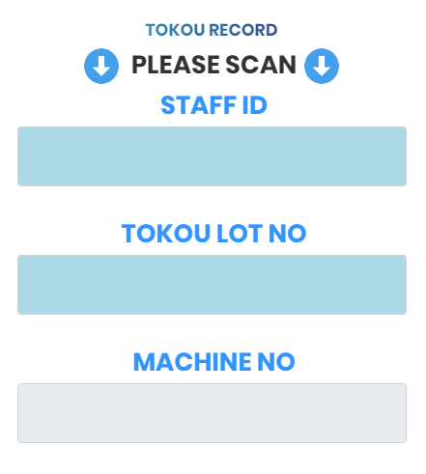
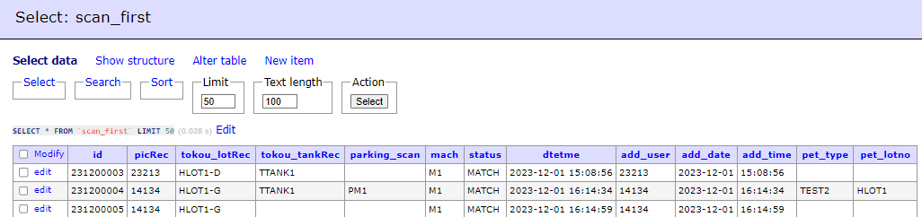
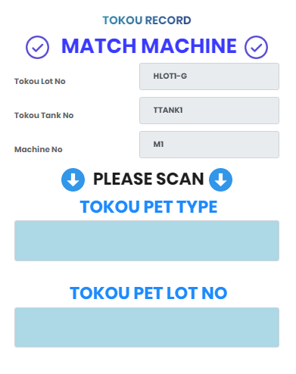
Haigou~Tokou Scanning System
Proposed the flow of data relocation for the tablet :
Creating Data Validation for the Scanner :
Create
Read
Server Database
Tablet UI
Create
Start
Machine Process
Data Evaluation UI
Tablet UI

